Slide 1

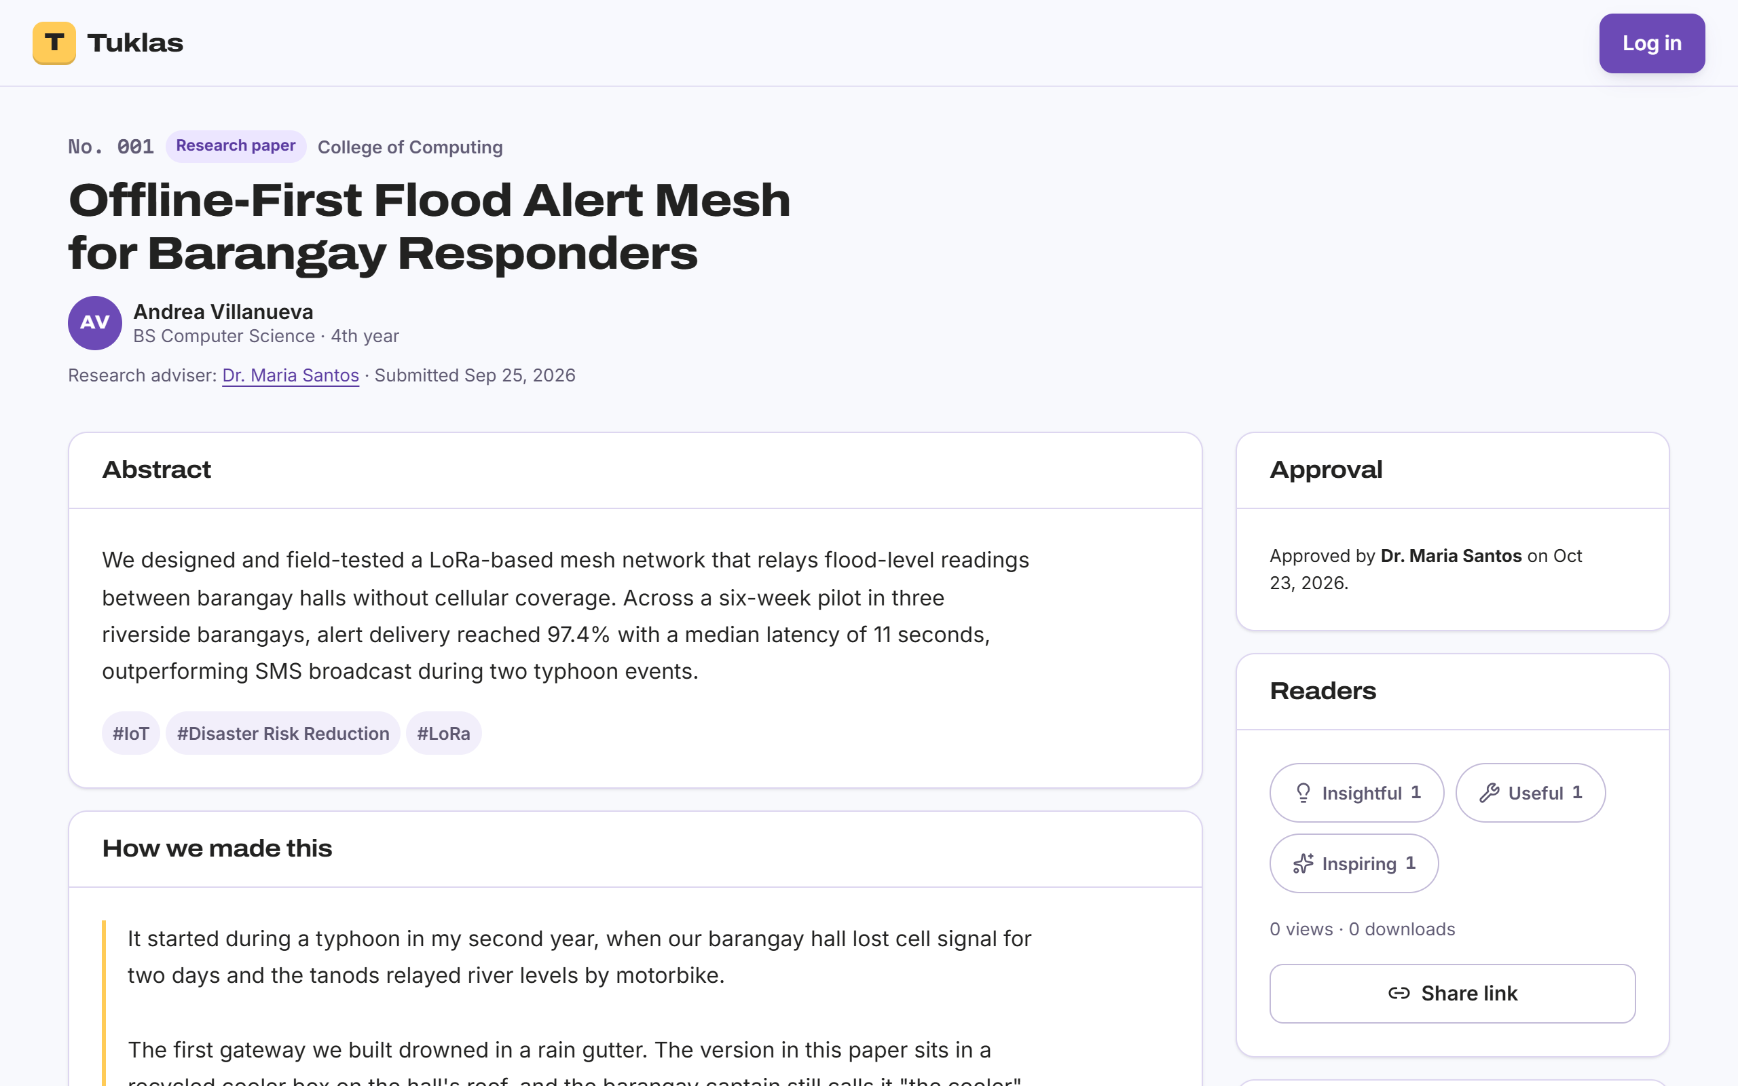
Tuklas
From Defense to Discovery
A research and academic engagement hub for students, educators and school research offices
A student’s research, approved by her adviser and open to everyone
Prepared by
Manla, Jun Mari · Limbadan, Benz Ashley · Rollon, Thirbby Andrei · Dumangas, Lian
Notes:
Tuklas means "discover" in Filipino. It is a website where students’ research, once their adviser approves it, can be found, read and cited by anyone.

Slide 2
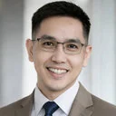

Company Background
Who he is
A Senior High School educator, researcher and part-time college instructor. He holds a Master of Arts in Education and is pursuing a Doctor of Philosophy in Educational Management at Holy Cross of Davao College.
Interests
Education
Student development
Bamie D. Bucog, MAEd
Sports performance
Educational management
Our client
Senior High School educator and researcher
Part-time college instructor
Doctor of Philosophy in Educational Management student, Holy Cross of Davao College
Committed to advancing knowledge through research, teaching and community engagement, while contributing to evidence-based educational practices.
His concern: Senior High School students write research papers that rarely reach anyone beyond their defense panel.
Notes:
Our client, Sir Bamie Bucog, teaches and advises research in Senior High School and teaches part-time in college. He is taking his PhD in Educational Management at Holy Cross of Davao College. The problem he brought to us: students do real research, but almost nobody ever reads it.

Slide 3




Where Student Research Ends Today
Practical Research
Defense
Bound copy
Forgotten
Grades 11 and 12: students write a research paper.
A panel of teachers reads it once.
A hardbound copy goes to the library shelf.
The next batch can’t find it, so topics repeat.
The other road: publishing
DepEd’s Research Management Guidelines
Journals and research congresses take months, cost money and have few slots for students. Most students never try.
DepEd Order No. 16, s. 2017 calls for research to be shared and used. Schools have no channel to share their students’ work.
Notes:
This is the usual life of a Senior High School research paper. The work is real, but after the defense it sits on a shelf. The formal road to an audience, a journal or a research congress, is long and costly, so few students take it.

Slide 4
Problems Encountered (PIECES)
1 of 3
P
Performance
I
Information
How long it takes to reach an audience
Whether research can be found and counted
Journal review takes months, and research congresses have few slots, so most papers are never presented.
Advisers handle many research groups at once; feedback is slow and scattered.
Finished papers become bound copies in the library: hard to find, read only on site, lost when the batch graduates.
Students repeat topics because they can’t see what earlier batches did.
The research office can’t count its research output for reports and accreditation.
Notes:
Performance: Journal review takes months, and research congresses have few slots, so most papers are never presented. Advisers handle many research groups at once; feedback is slow and scattered.
Information: Finished papers become bound copies in the library: hard to find, read only on site, lost when the batch graduates. Students repeat topics because they can’t see what earlier batches did. The research office can’t count its research output for reports and accreditation.

Slide 5
Problems Encountered (PIECES)
2 of 3
E
Economics
C
Control
What sharing research costs
Quality, ownership and privacy
Printing and binding copies, journal publication fees and travel to congresses cost students money.
Most schools can’t afford their own research repository or the staff to run it.
Posting research on social media has no quality check and no record of who wrote it first.
No one is accountable for plagiarism or harmful content.
Students, most of them minors, expose personal data when they post online.
Notes:
Economics: Printing and binding copies, journal publication fees and travel to congresses cost students money. Most schools can’t afford their own research repository or the staff to run it.
Control: Posting research on social media has no quality check and no record of who wrote it first. No one is accountable for plagiarism or harmful content. Students, most of them minors, expose personal data when they post online.

Slide 6
Problems Encountered (PIECES)
3 of 3
E
Efficiency
S
Service
How the work gets done
What students and readers get
Revisions travel by Messenger, email and printouts; versions get lost, and fixed comments are hard to track.
Group work and deadlines live in group chats: files get buried, and late submissions go unnoticed.
Research events are announced and registered for on paper.
Students get little recognition; their research has no audience outside the panel.
Student work can’t be found by search engines or cited properly.
Students mostly have phones and slow connections, not computers.
Notes:
Efficiency: Revisions travel by Messenger, email and printouts; versions get lost, and fixed comments are hard to track. Group work and deadlines live in group chats: files get buried, and late submissions go unnoticed. Research events are announced and registered for on paper.
Service: Students get little recognition; their research has no audience outside the panel. Student work can’t be found by search engines or cited properly. Students mostly have phones and slow connections, not computers.

Slide 7





The Solution: Tuklas
Visitors
Tuklas gives student research a public home.
Read and cite approved research, no account needed
Students
Build a portfolio, submit works, join research groups
Advisers approve it, the school keeps it, and anyone can find, read and cite it, on a computer or a phone.
Educators
Review and approve works, run groups, publish their own research
Admins (research office)
Verify educators, approve events, moderate content
Super-admins
Open-source, multi-school, free to use
Run several schools on one site
Notes:
Tuklas is a website, also installable as an app. It has five kinds of users. Visitors need no account. Students and educators sign in with their school email. Each school’s research office runs its part of the site.

Slide 8
How Tuklas Answers PIECES
P
Performance
I
Information
E
Economics
Public as soon as the adviser approves: no months-long wait. One review board per adviser.
A searchable library and portfolios; similar works shown while typing keywords; statistics for the research office.
Free to read and publish, built on open-source software; one site shared by several schools.
C
Control
E
Efficiency
S
Service
Nothing goes public without approval; every version is kept; reports, moderation and an audit log.
Revision checklists and version history; research groups with deadlines and hand-ins; online event registration.
Google Scholar tags and APA and MLA citations; works on phones and installs like an app.
Notes:
Each problem area has a direct answer in the system. The next slides show the core workflow and the main features.

Slide 9



From Draft to Discovery
Student
Student
Adviser
Adviser or academic panel
Draft
Submitted
Under review
Approved & public
returned with
a checklist
rejected
revise &
resubmit
Needs revision
Rejected (final)
Every version kept
Private until approved
Approver on record
Each resubmission is saved with its review history.
Only the authors, adviser and Admins see it before then.
The public page names who approved the work and when.
Notes:
This is the core rule from our client: a student’s work becomes public only after the research adviser, or the school’s academic panel, approves it. The adviser can return it with a checklist of fixes; the student revises and resubmits; every version is kept. The full state diagram is Figure 7 of the SRS.

Slide 10









Key Features
Portfolios
Adviser review
Library and citations
A public academic page for every member, with verified honors.
Submit, review, revise and approve, with every version kept.
Search and filter research; APA 7 and MLA 9 in one click.
Research groups
Chat
Events
Channels, files, deadlines and deliverables with feedback.
Direct and group messages, live, stored encrypted.
Academic events with registration; mentorships and grants.
Announcements
Moderation
Several schools
To a school, department or group; alerts in the app, by email or push.
Reports, removal, warnings and an audit log.
One site; each school’s research office runs its own part.
Notes:
Twelve feature areas are specified in Section 4 of the SRS, with 87 functional requirements. These nine are the ones users see most.

Slide 11
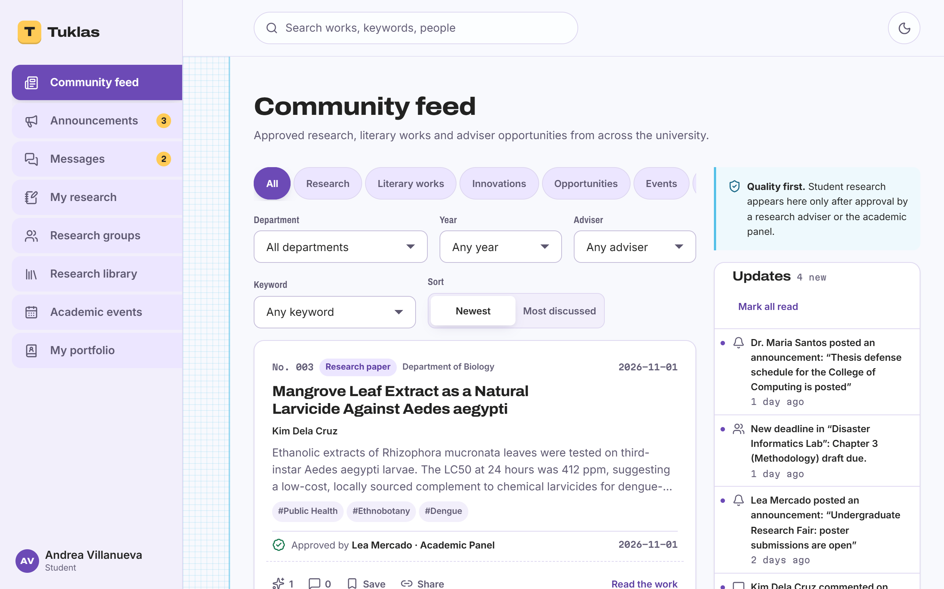
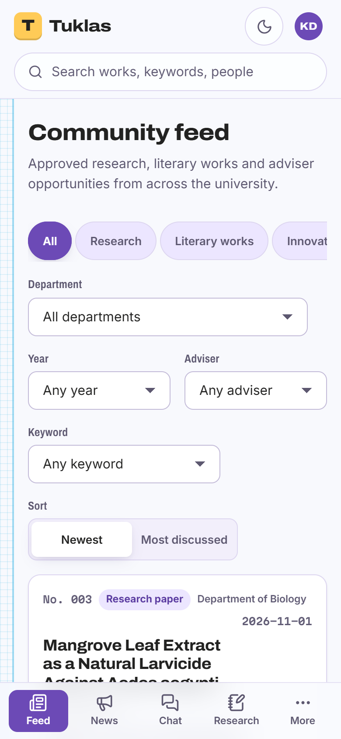
A Look Inside: Students
The community feed: approved works, opportunities and events, with filters
The same feed on a phone
Notes:
Students land on the community feed. Everything here has been approved. The same site works on a phone and can be installed like an app.

Slide 12
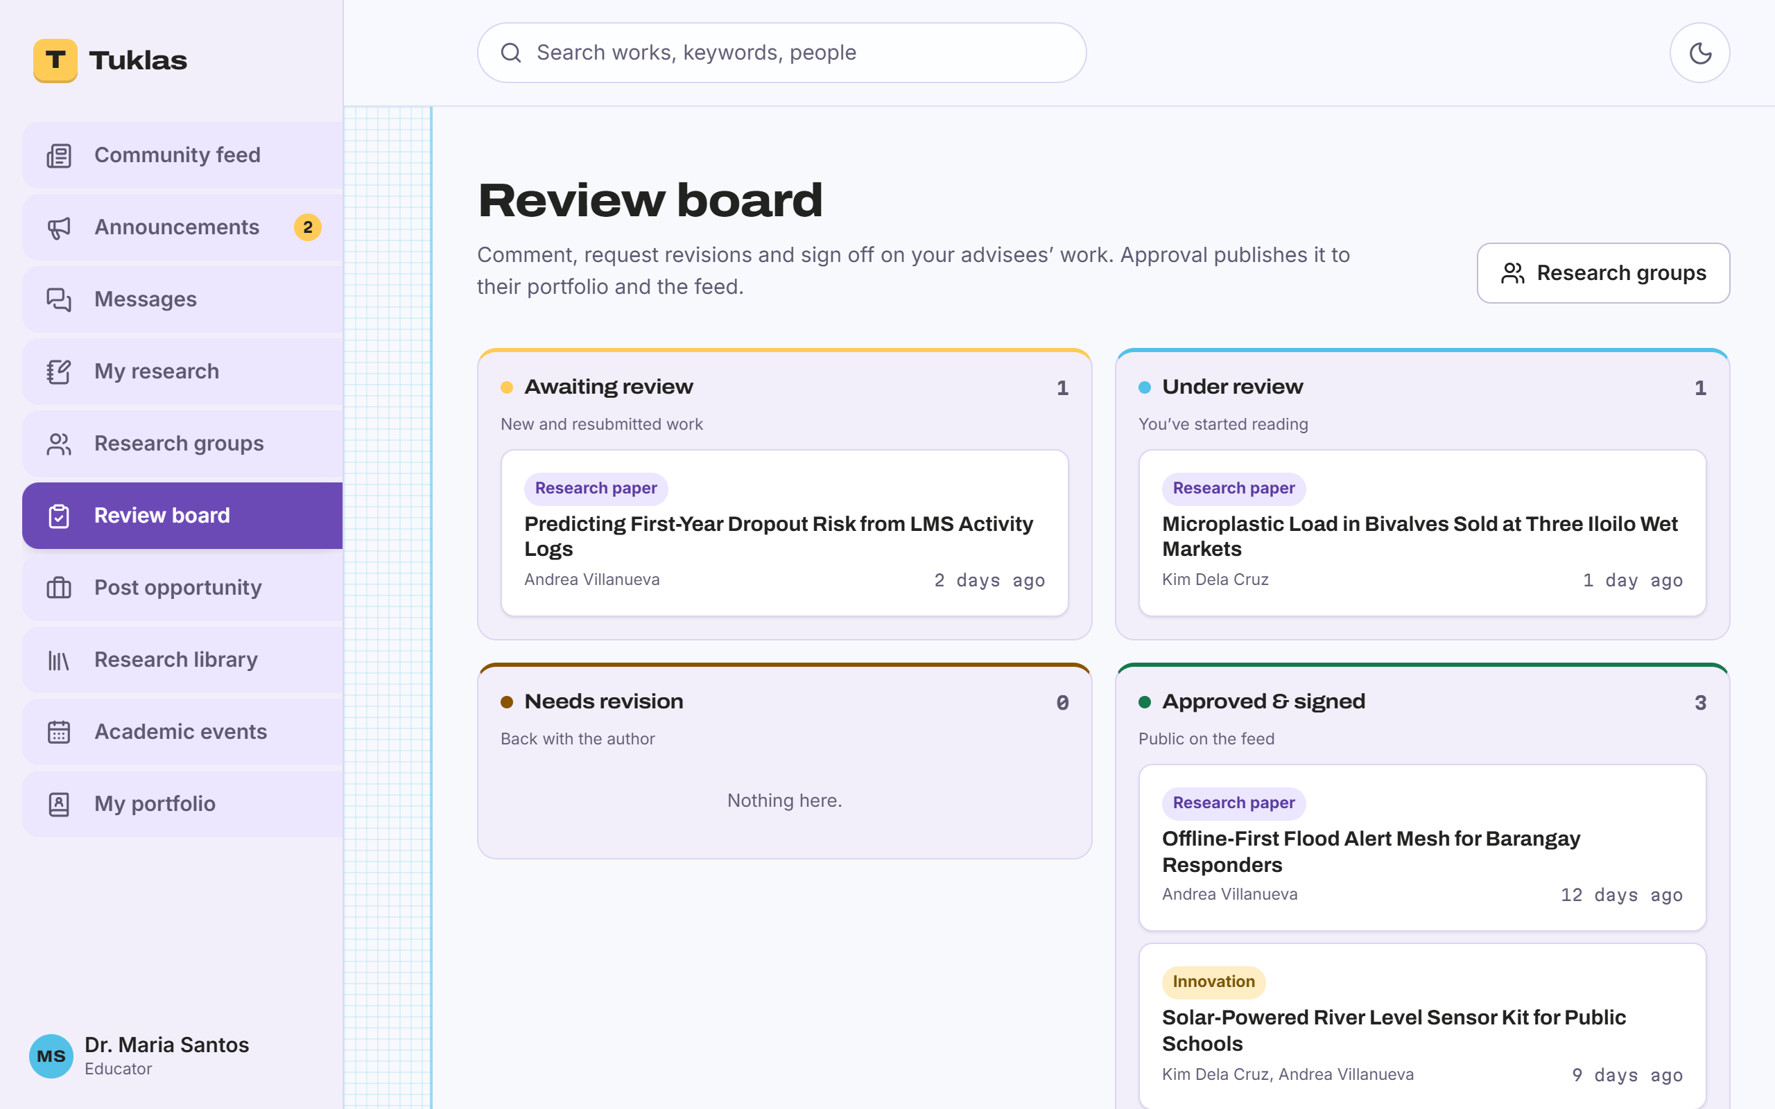
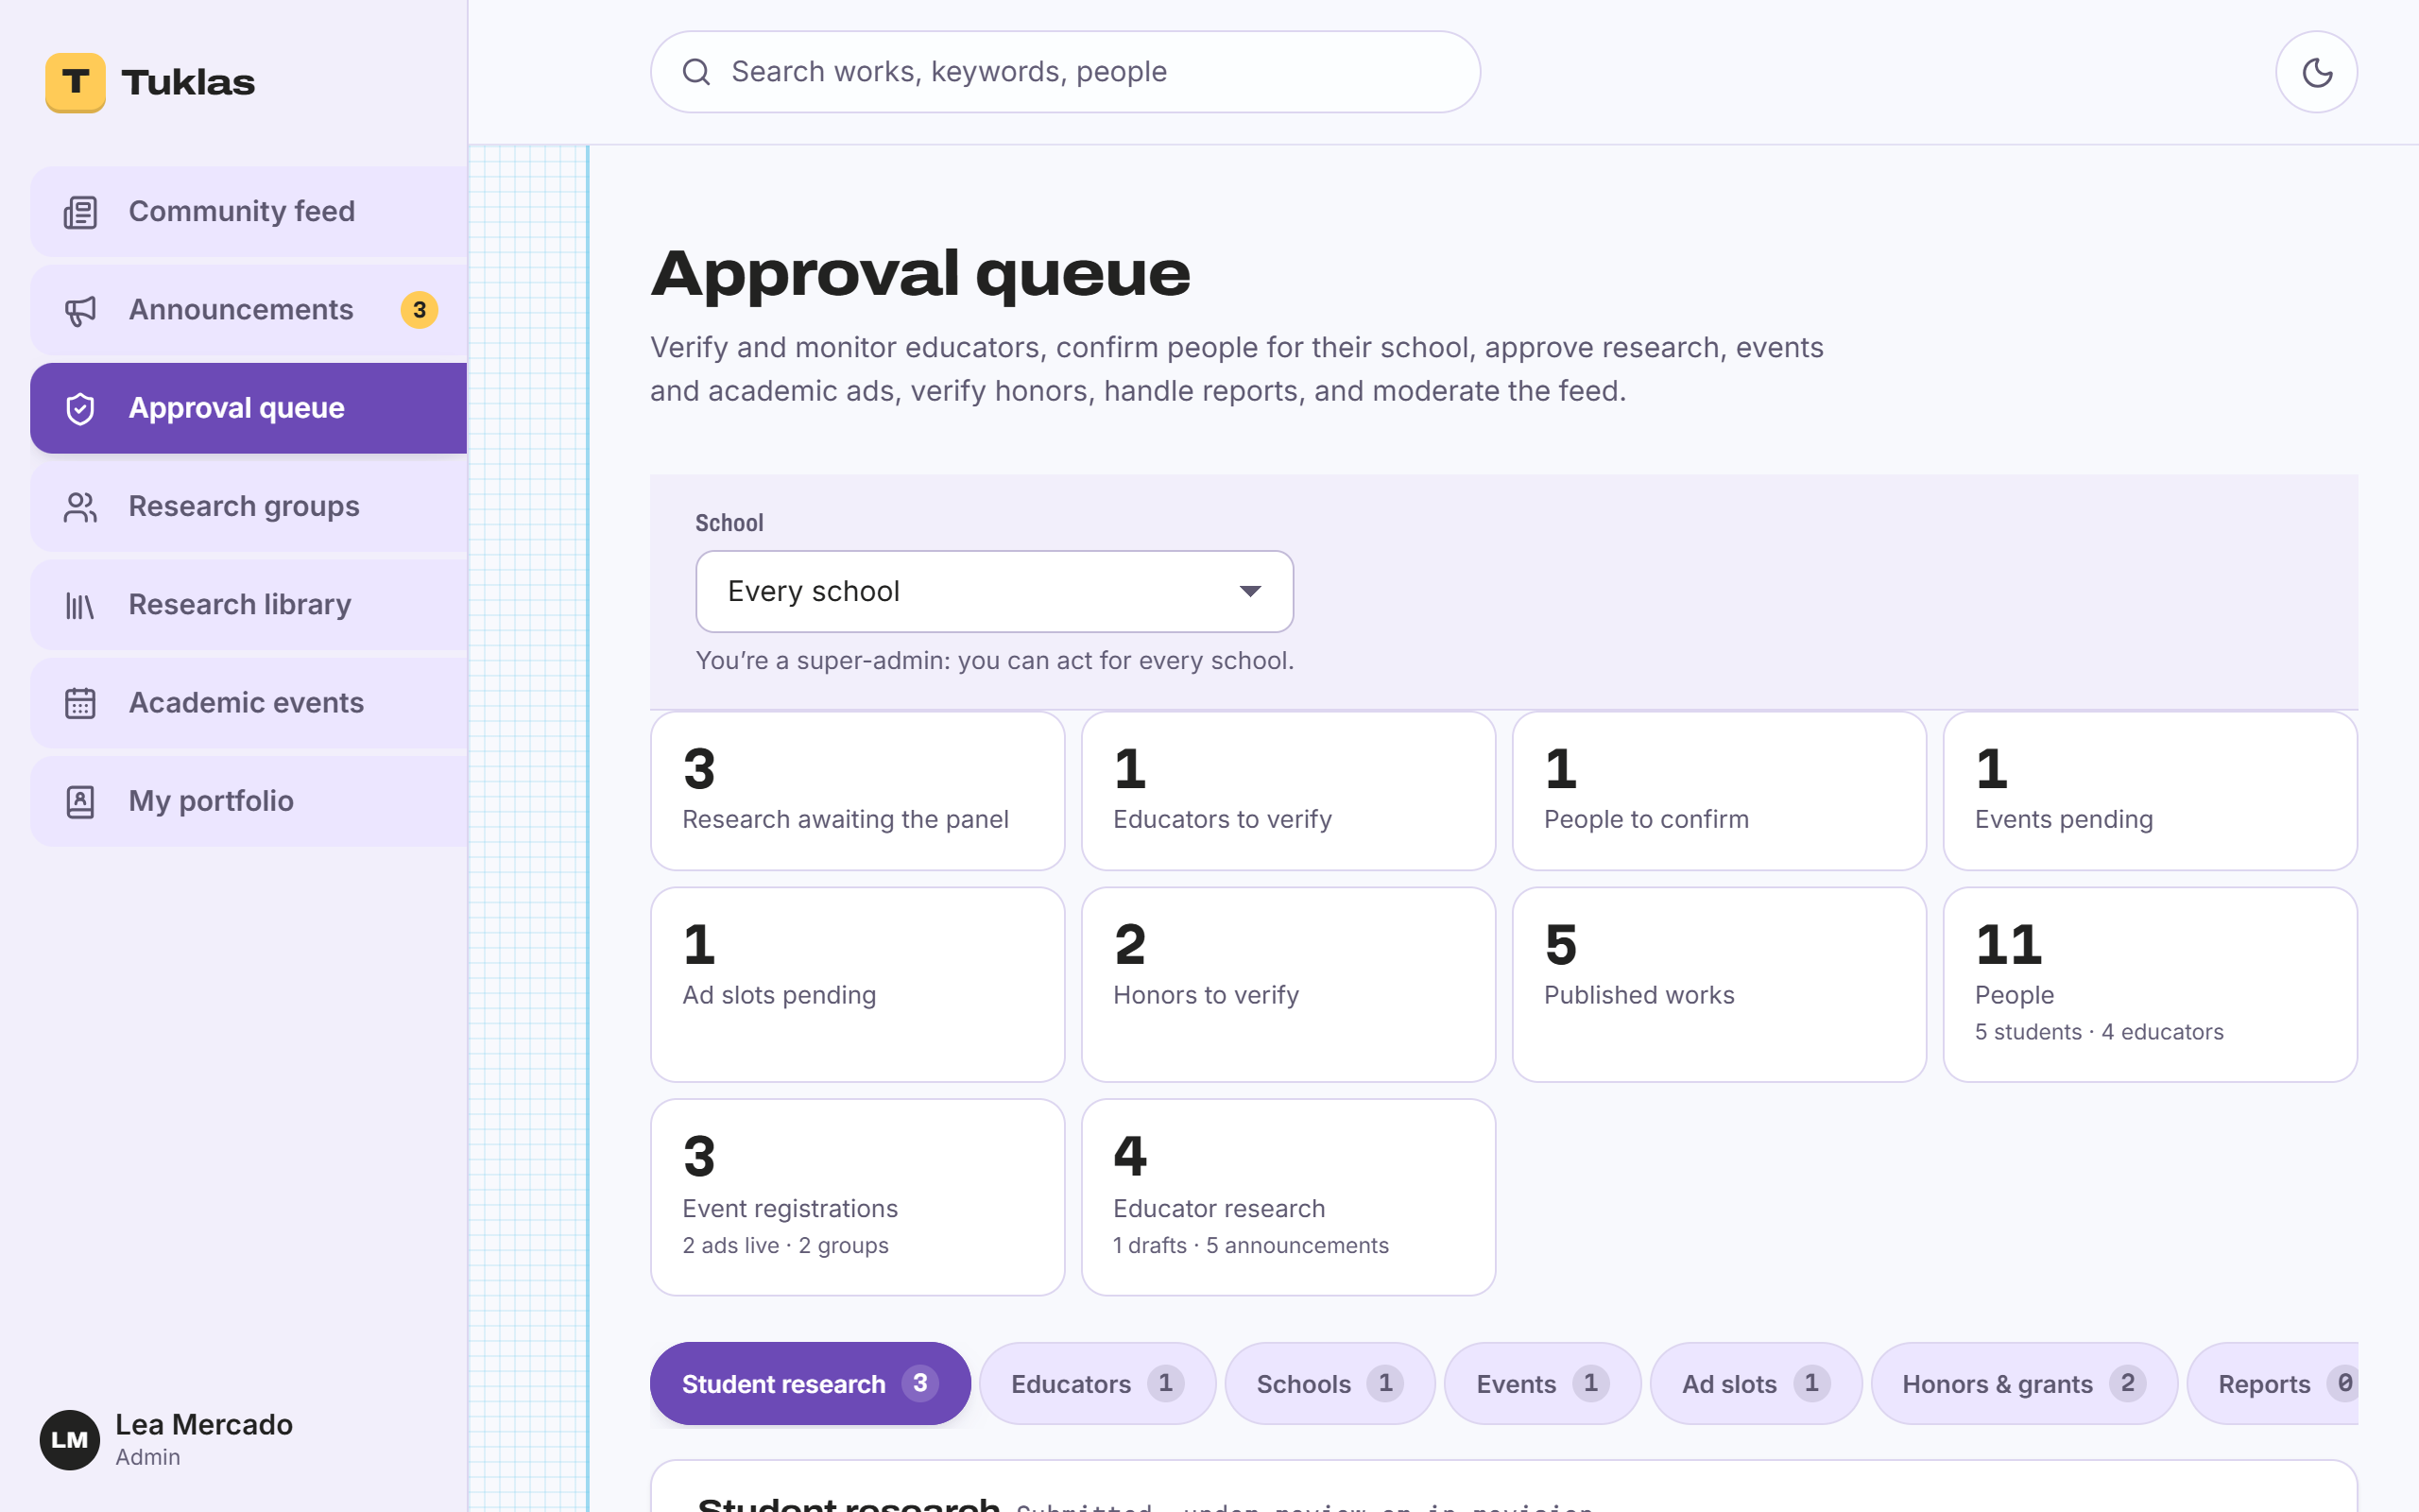
A Look Inside: Educators and the Research Office
An adviser’s review board: awaiting review, under review, needs revision, approved
The research office’s approval queue, with the school’s statistics
Notes:
Advisers see every work they handle on one board. The research office verifies educators, approves events and handles reports from its approval queue.

Slide 13
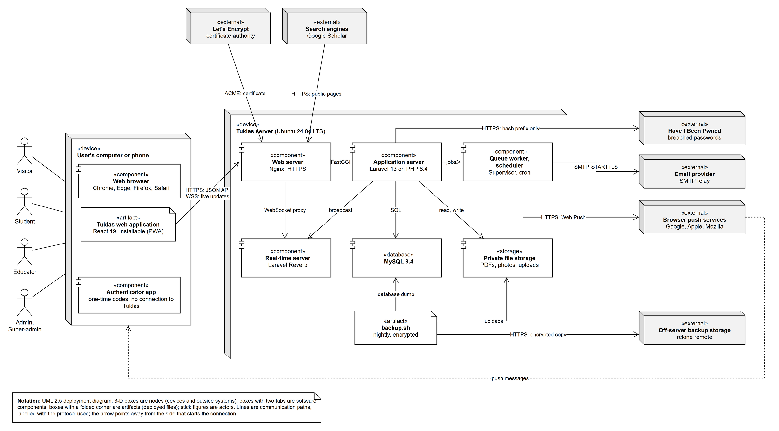





System Architecture
Laravel 13 on PHP 8.4
The server and its API
React 19
The web app, installable on phones
MySQL 8.4
The database
Laravel Reverb and Web Push
Live updates and notifications
Nginx on Ubuntu, Azure
UML deployment diagram (SRS Figure 1)
The server, with nightly encrypted backups
Notes:
One server runs everything: the web server, the Laravel application, the real-time server, the queue worker and the database. Browsers talk to it over HTTPS and an encrypted WebSocket. Emails go out through an email provider, and backups are copied off the server.

Slide 14




Security and Data Privacy
Data Privacy Act
Two-factor sign-in
Encryption
RA 10173: consent at sign-up; members can download their data and delete their account.
Required for Educators and Admins, optional for Students.
HTTPS everywhere; chat, comments and review notes stored encrypted (AES-256).
Each school’s data
Strong passwords
Built to a standard
Admins act only for their school; hidden items answer “not found”.
At least 12 characters, checked against known breaches, hashed with Argon2id.
Requirements follow OWASP ASVS 4.0.3 Level 2 and the OWASP Top 10.
Notes:
Tuklas holds students’ personal data, and many Senior High School students are minors, so privacy was a requirement from the start. Section 5.3 of the SRS lists all 17 security requirements.

Slide 15


Test Results: Automated Tests
Checked on every change (GitHub Actions)
223 / 223
Feature tests
On MySQL 8, the database the server uses
feature tests passed
Code style
Laravel Pint
1,433 assertions
Static analysis
Larastan, level 5
Each test checks what a role may do, what is refused, and what stays hidden.
Web app
Type check, lint and production build
Dependencies
Audited for known vulnerabilities (Composer and npm)
Notes:
The automated suite has 223 feature tests with 1433 assertions; all of them pass. They run on every change pushed to GitHub, together with code style, static analysis, the web app's checks and a vulnerability audit of the libraries we use.

Slide 16
Test Results: QA Checklist
150 / 153
checks passed
17 areas
every role, both demo schools, phone and computer
Tested by
Dumangas, Lian (QA)
Notes:
The QA checklist has 153 checks in 17 areas, built from the requirements in the SRS. All checks passed.

Slide 17
Limitations and Future Enhancements
Release 1.0 today
Next
One named adviser approves each work
Blind review, with reviewers from another school
Plagiarism is reported by members, not detected
Automatic plagiarism checking
No parent or guardian consent step for minors
Guardian consent, as the Data Protection Officer advises
Educators and Admins can’t move two-factor sign-in to a new phone
Moving two-factor sign-in to a new phone; passkey sign-in
Runs on a student cloud server
A permanent production host and domain
Notes:
These are the known limits of release 1.0 and what we plan next. For now each work is approved by a named adviser, which matches how Senior High School research is supervised; blind review is planned as an enhancement.

Slide 18



The Team
JM
BL
TR
LD
Manla, Jun Mari
Limbadan, Benz Ashley
Rollon, Thirbby Andrei
Dumangas, Lian
Developer
Project Manager
Documentation
Quality Assurance
Notes:
Jun Mari built the system, Benz Ashley managed the project, Thirbby Andrei wrote the documentation, and Lian ran quality assurance.

Slide 19
Thank you
Questions and answers
Tuklas · From Defense to Discovery

